Slide 1
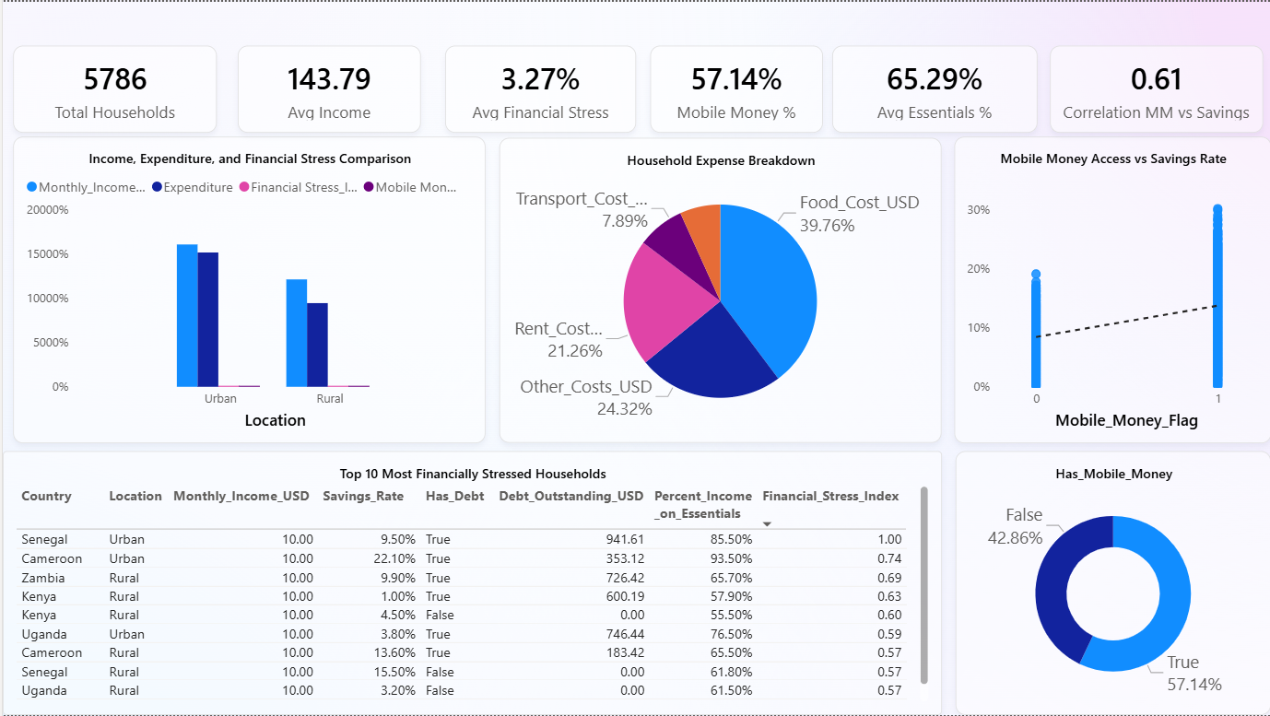





Cost of Living and Financial Stress Analysis Across Urban and Rural Households

Slide 2
KEY INSIGHTS
This analysis examines 5,786 households to understand financial stress patterns and the role of mobile money across urban and rural areas.
Insight 1: Urban vs Rural
Urban households earn more on average, but essential expenditure remains high across both groups. Rural households show slightly higher financial stress
Insight 2: Expense Structure
Food and rent together account for the majority of household expenditure, indicating that cost-of-living pressure is primarily driven by essential consumption.
Insight 3: Mobile Money & Savings
The strongest finding is a moderately strong positive correlation of 0.61 between mobile money access and savings rate. This suggests digital financial tools may significantly improve household financial resilience.”
This implies that improving digital financial inclusion could strengthen savings behavior. However, reducing financial stress also requires addressing high essential expenditure and debt burden.

Slide 3
RECOMMENDATIONS
Expand digital financial inclusion to improve savings behavior.
Reduce cost-of-living pressure to lower financial stress.
Strengthen debt management and financial literacy frameworks.

